Slide 1
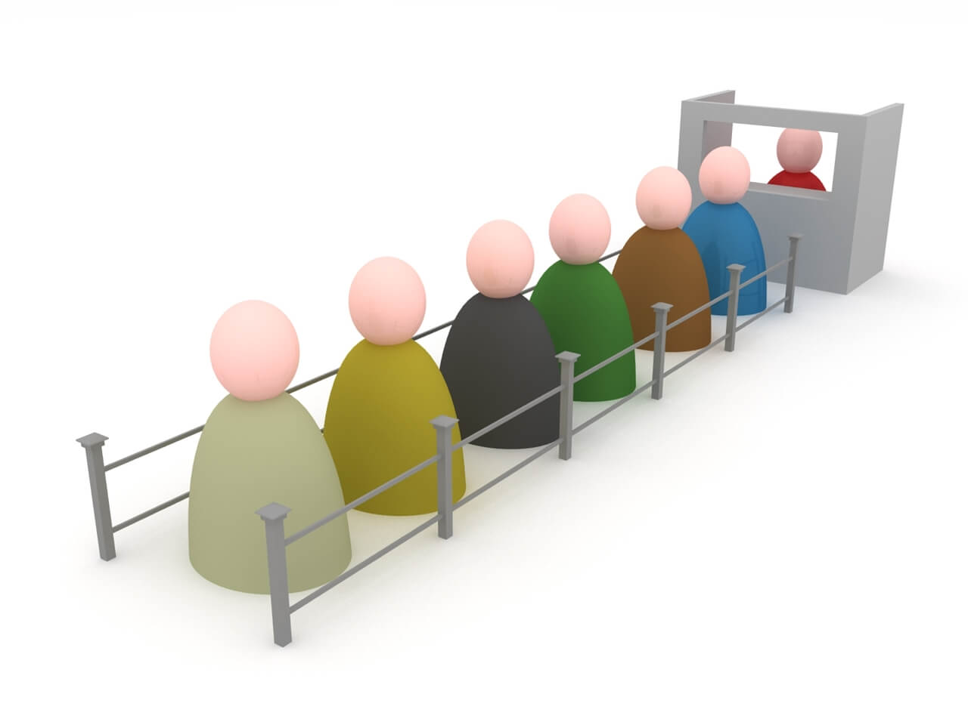
Queue
J.Govindarajan, Asst.Prof. (Sr.Gr) ,
CSE

Slide 2
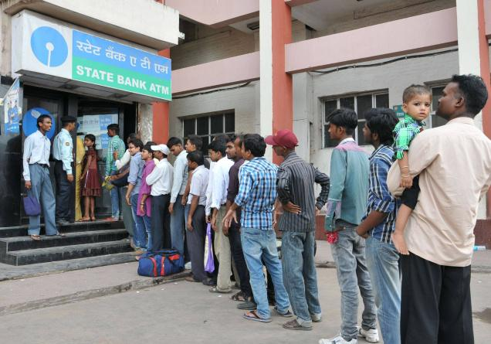
Stack – Real Time Analogy
First In First Out (FIFO)

Slide 3
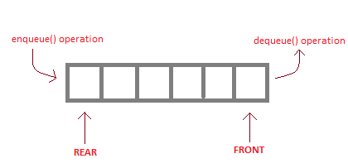
Queue
First-In-First-Out (FIFO) ADT
Linear Data Structure
The element that has been in the queue the longest can be removed

Slide 4
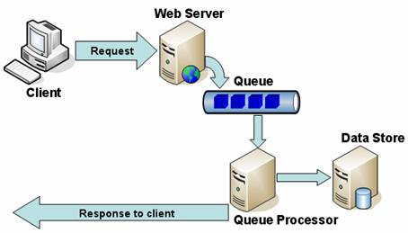
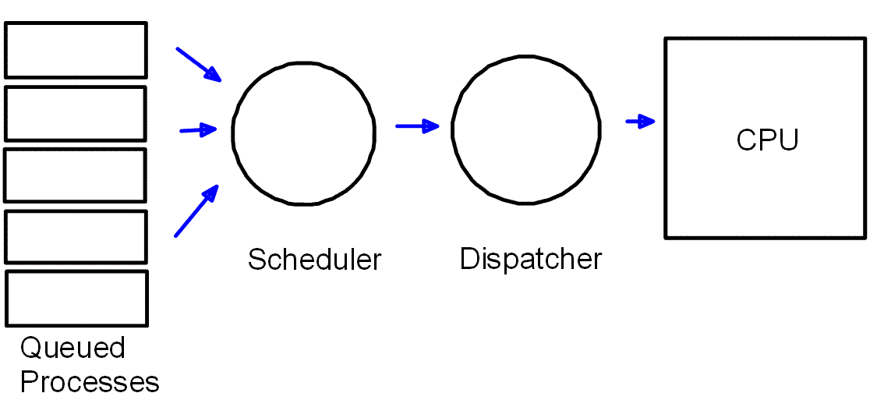
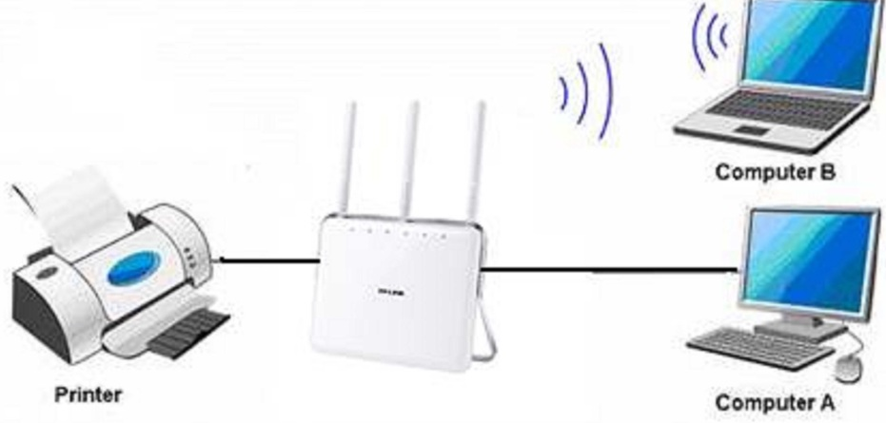
Applications of Queue in computer science
Webserver responding to client requests
CPU Scheduling
Printer Sharing

Slide 5
Queue ADT
Update Methods
enque(e):
Adds element e to the back of the queue.
- dequeue( ):
Removes and returns the first element from the queue (or null if the queue is empty).

Slide 6
Queue ADT
Accessor Methods
- first():
Returns the first element of the queue, without removing it (or null if the queue is empty).
- size( ):
Returns the number of elements in the queue.
- isEmpty( ):
Returns a boolean indicating whether the queue is empty

Slide 7
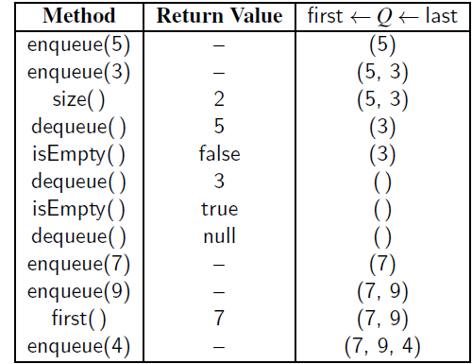
Queue : Example

Slide 8
Queue Operations : Exceptions
3
2
1
Queue is empty
Queue is Full
0
dequeue() will throw error
front (f)
3
rear (r)
50
2
front (f)
rear (r)
15
1
enqueue() will throw error
0
40
20

Slide 9
Queue ADT => Queue Interface in Java
public interface Queue<E> {
int size(): //returns number of objects in the queue
boolean isEmpty(); //returns true if queue is empty, false otherwise
E first(); //returns first object in queue throws exception if queue empty
void enque(E element): //inserts object at rear of the queue
E dequeue(); // Removes and returns the first element from the queue (or null if empty)
}

Slide 10
Queue ADT Operations : Algorithm Design

Slide 11
Queue ADT: Initial State
3
2
front = -1
rear = -1
(for theoretical)
1
0
front (f)
rear (r)

Slide 12
Queue ADT: enque(e)
3
3
Algorithm enque(e)
if size() < N then
rear → rear +1
S[rear] → e
if (front==-1) then
front=0
rear (r)
rear (r)
50
front (f)
2
front (f)
2
1
1
15
15
0
0
40
40
20
20
Before enque(50)
After enque(50)

Slide 13
Queue ADT: deque()
3
3
Algorithm deque()
if not(isEmpty()) then
if (front==rear) then
rear = -1
e → S[front]
front → front + 1
return e
else
throw QueueEmptyException
front (f)
rear (r)
front (f)
rear (r)
50
50
2
2
1
1
15
15
0
0
40
40
20
Before deque()
After deque()

Slide 14
Queue ADT : size() and isEmpty()
Algorithm size()
if (r==-1) then
return 0
else
return (r-f+1)
50
rear (r)
front (f)
15
3
40
2
Algorithm isEmpty()
if (size() == 0) then
return true
else
return false
1
0
front (f)
rear (r)

Slide 15
Queue ADT : front()
Algorithm front()
if isEmpty() then
throw QueueEmptyException
else
return S[front]
50
rear (r)
front (f)
15
40

Slide 16
Queue Stack ADT operations : Circular queue

Slide 17
Circular Queue ADT: Initial State
3
2
0
3
front = -1
rear = -1
(for theoretical)
1
0
front (f)
rear (r)
2
1
Allow f and r to wrap around to end of queue

Slide 18
Circular Queue ADT: enqueue(e) and deque()
Algorithm deque()
if not(isEmpty()) then
if (front==rear) then
rear = -1
e → S[front]
front → (front + 1) mod N
return e
else
throw QueueEmptyException
Algorithm enque(e)
if size() < N then
rear → (rear +1) mod N
S[rear] → e
if (front==-1) then
front=0
O(1)
O(1)

Slide 19
Circular Queue ADT : size() and isEmpty()
Algorithm size()
if (r==-1) return 0
else if (r >=f ) return (r-f+1)
else return (N-f+r+1)
50
rear (r)
front (f)
50
front (f)
rear (r)
15
40
40
O(1)
20
Algorithm isEmpty()
if (size() == 0) then
return true
else
return false
3
2
1
0
Top
O(1)

Slide 20
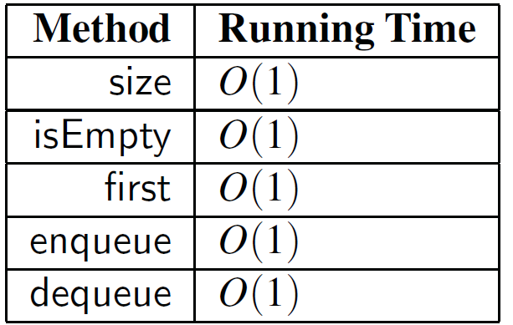
Queue ADT
Space Complexity O(N) => independent of queue size n
where, N is size of array

Slide 21
Double ended queue

Slide 22
Double Queue (DEQueue)
3
2
dequeue()
dequeue()
1
0
enqueue()
enqueue()

Slide 23
Double Queue (DEQueue) ADT
3
2
removeFirst()
removeLast()
1
0
insertFirst(e)
insertLast(e)
first()
last()
size()
isEmpty()

Slide 24
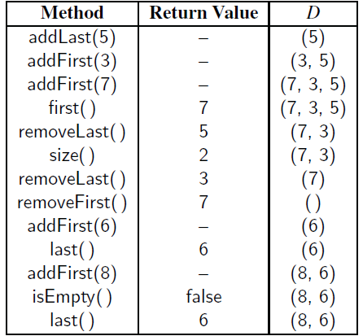
Double Queue (DEQueue)

Slide 25
Exercise

